Slide 1

CAP 6737 – Project Proposal ------------------------- US Mass Shootings 2019 - 2023
- Harishma Ashok

Slide 2
Motivation
- The gun violence and school shootings are increasing very rapidly in the recent days.
- Exploring and visualizing the spread of number of injuries and killed persons across different states in US.

Slide 3
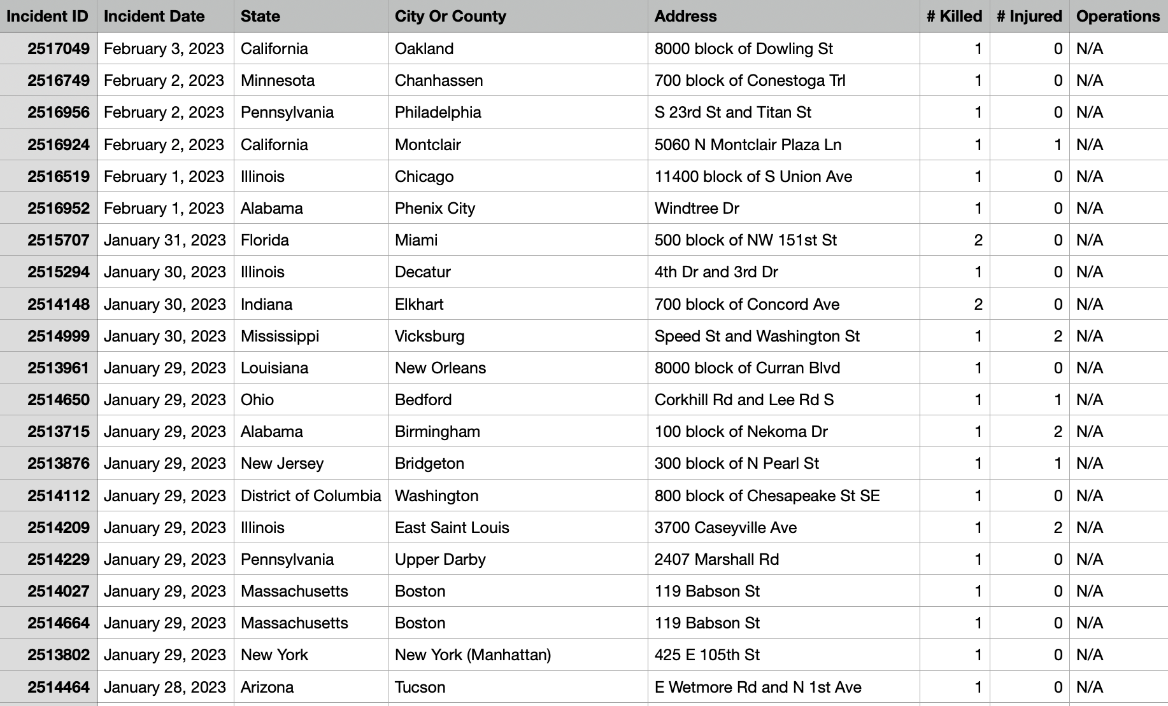
Dataset
# of records : 12000
# of columns : 8
Incident ID
Incident Date
Incident State
City or County
Address
# killed
# injured
Operations

Slide 4


Questions
Mass shootings by year
Which city has the most dangerous gun violence?
When does most of the gun violence happen?
Weekdays or weekends?
Summer or spring or winter?
Who are being killed the most?
Teens or children?
What type of guns are involved?
# of teens killed by states
# of children killed by states
# of teens injured by states
# of children injured by states

Slide 5
Tools
Data Manipulation
Python
R
Data Visualization
PowerBI
Tableau
Observable
DeckGL

